Slide 1
Functional Neurological Disorders: not all that shakes is seizure
Cynthia Morris, MD
Assistant Professor of Pediatric Neurology
SSM Cardinal Glennon Children’s Hospital
St. Louis, MO

Slide 2
Disclosure
I have no relevant financial relationships to disclose.

Slide 3
Objectives
Define Functional Neurological Disorders (FNDs) and Psychogenic Non-epileptic Seizures (PNES)
Describe some common features/findings of these disorders
Discuss school response plans for Functional Neurological Disorders

Slide 4
What *is* a functional neurological disorder?
Essentially, when neurological symptoms are due to abnormal functioning of communication in the brain, rather than structural.
Think “software” vs “hardware”
Psychogenic Non-epileptic Seizures - a particular type of FND that physically resembles epileptic seizures.
Non-volitional, though patients may be able to inhibit symptoms voluntarily

Slide 5
Antiquated Terms
“Conversion disorder”
“Pseudoseizure”
“Psychogenic illness”
“Non-organic illness”
“Hysteria”

Slide 6
Official diagnostic criteria:
DSM-5:
A. One or more symptoms of altered voluntary motor or sensory function.
B. Clinical findings provide evidence of incompatibility between the symptom and recognized neurological or medical conditions.
C. The symptom or deficit is not better explained by another medical or mental disorder.
D. The symptom or deficit causes clinically significant distress or impairment in social, occupational, or other important areas of functioning or warrants medical evaluation.
Specify symptom type:
With weakness or paralysis
With abnormal movement (e.g., tremor, dystonic movement, myoclonus, gait disorder)
With swallowing symptoms
With speech symptom (e.g., dysphonia, slurred speech)
With attacks or seizures
With anesthesia or sensory loss
With special sensory symptom(e.g., visual, olfactory,or hearing disturbance)
With mixed symptoms
Specify if:
Acute episode: Symptoms present for less than 6 months.
Persistent: Symptoms occurring for 6 months or more.
Specify if:
With psychological stressor (specify stressor)
Without psychological stressor

Slide 7
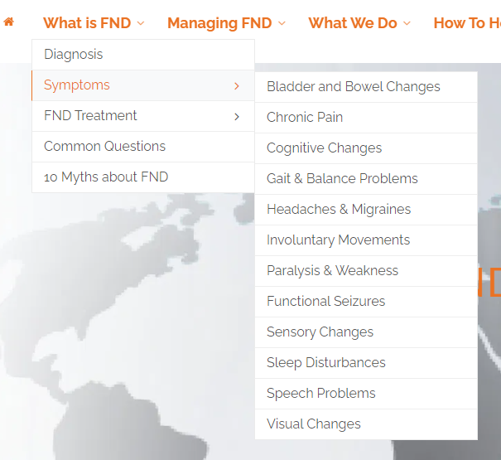
Features of FNDs

Slide 8
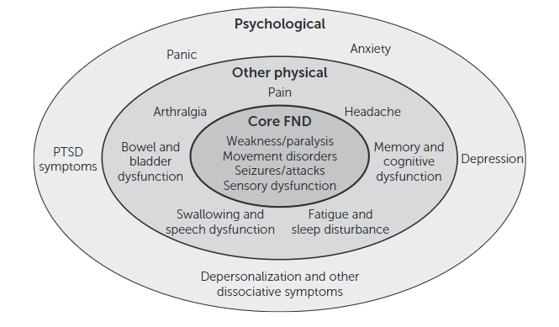

Slide 9
Most common types
Non-epileptic seizures (PNES)
Functional weakness
Jerks/tics
Cognitive

Slide 10
General Features
Kids are generally not consciously controlling their symptoms - even if they seem clearly triggered in certain settings or have odd features to them.
Conceptually similar to panic attacks
Subconscious control preventing injuries, regulating breathing, and overall maintaining safety remain intact. (unlike with epileptic seizures)
Acute episodes are not emergencies, even if they look scary.
Features and frequency of episodes often change over time (especially with non-epileptic seizures)

Slide 11
Psychogenic Non-epileptic Seizures (PNES)

Slide 12
Naming Discrepancies
We use the term PNES because it’s the most consistent option we have at the moment - but not a great one.
Significant debate on the best terminology:
Functional - dissociative - psychogenic?
Seizures - attacks - spells?

Slide 13
Psychogenic Non-epileptic Seizures
Most common FND in people under 18yo
Common features include:
staring off
unresponsiveness
eyes moving/rolling back/fluttering
slumping/“losing consciousness”
partial or generalized shaking and/or stiffening
heavy/irregular breathing, “gasping”

Slide 14
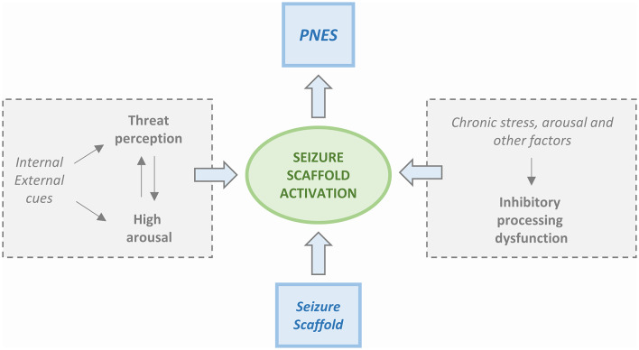
Why do PNES happen?
Sequence of perceptions and motor activities shaped by experiences like inherent reflexes or physical symptoms

Slide 15
Epileptic versus non-epileptic seizure?
Observed | Epileptic Features | Non-epileptic Features
Head movements | Fixed | Side-to-side
Eyes
Eyelids | Open | Closed
Light Reflex | Absent | Present
Corneal Touch | No Response | Guarding Response
Vocalizations | Rare | Yes
Tongue Injury | May bite side(s) | May bite the tip
Limb Movements
Synchronous | Yes | No
Continuous | Yes | No
Typical | Yes (tonic, clonic, both) | No
Duration (commonly) | <3 minutes | More than 3 minutes

Slide 16
Epileptic vs. non-epileptic: Details
Movements
Asynchronous, non-stereotyped movements that change throughout episode
No rapid contraction with slow relaxation from true GTCs
Pelvic thrusting
Side-to-side head movements: violent and high amplitude
Opisthotonic posture
Eyes
Closure – especially forceful closure, resist attempts to open eyelids
Back and forth/roving movements
CAN “roll back in head”, especially if pulled open

Slide 17
Epileptic vs. non-epileptic: Details
Vocalizations
Epileptic seizures can start with a particular yell/cry
PNES – moans, screams, retching, stuttering, weeping more common
Ictal stuttering – one study showed this in 8.5% of PNES, none in epileptic seizure
Guarding/Posture
May slump in chair or fall slowly
Unlikely to fall abruptly to the ground

Slide 18
Post-ictal phase
Observed | Epileptic Features | Non-epileptic Features
Breathing
Deep | Yes | No
Regular | Yes | No
Loud | Yes (with snoring) | No
Duration of abnormal breathing | 5 minutes | 1 minute
Recall of episode events | No | Yes

Slide 19
Epileptic vs. non-epileptic: Triggers
Some things can trigger either type –especially illness
Illness
Head trauma (generally only mild for PNES, either for epileptic)
Unique to PNES
Stress/mood/social event
Anticipation
Lights?
Actually quite rare for epileptic seizures, very common for PNES

Slide 20
But it’s more complicated than that
10%-20% of patients with PNES also have epileptic seizures
12% of patients with epilepsy also have PNES
In almost all cases epileptic seizures occurred first
New features do not generally mean nonepileptic seizures are now possibly epileptic
Neurologist will work with patients and families to try and identify which seizures are epileptic, however this can be challenging.
If seizure action plans are not clear or specific enough, feel free to inquire with provider

Slide 21
Functional Weakness
The second most common FND:

Slide 22
Functional Weakness
Difficulty moving one or multiple parts of the body.
Often results in inability to walk, stand, or do manual tasks.
Can often be accompanied by pain or numbness.
Can be episodic or persistent.

Slide 23
Just to make things more complicated:
The most common presentation of functional neurological disorders is of combined symptoms.
Patients can have symptoms from multiple categories within the same attack, and can have a wide variety of attack types.

Slide 24
Who gets FNDs?
Used to think it was due to trauma or psychological factors
Only ⅓ diagnosed have clearly associated history
Increased incidence since COVID
90% increase in pediatric population
Motor and seizure type FND reported after COVID-19 vaccine

Slide 25
How are FNDs diagnosed?
A thorough history and exam looking for specific patterns for diagnosis.
Used to be considered a diagnosis of exclusion
We now better realize that this is a primary diagnosis like any of our other neurological concerns.

Slide 26
Some particulars for PNES diagnosis
“Gold standard” for PNES diagnosis is capturing an event on EEG to assess brain wave activity during the event
Events are often very spaced out so hard to capture
Some types of epileptic seizures don’t show up well on EEG (occur deeper in the brain)
Seizure is ultimately a clinical diagnosis (epileptic or non-epileptic) – seeing a video can give us plenty of clinical information to make the diagnosis.

Slide 27
Shouldn’t we be doing more testing?
A common question, especially given how startling symptoms can be and how severely debilitated patients can be.
This condition is diagnosed based on history and clinical symptoms, there are no tests to confirm it.
Additional testing furthers the concept of a severe/high risk medical condition, which can prolong and exacerbate symptoms and limit acceptance of the diagnosis
Waiting for additional testing before providing appropriate treatment/therapies can be highly detrimental - early diagnosis and treatment initiation is key for functional neurological disorders

Slide 28
What if something seems off?
In general, if you have concerns (especially if you feel the diagnosis may be incorrect) please reach out to the diagnosing provider
Conflicting input from different sources can cause significant issues with acceptance, treatment, and resolution of symptoms.
Conflicts are often due to well-meaning people expressing their concerns on the accuracy of the diagnosis with the patient and/or family
FNDs are uncommon and often foreign to those involved in care (even to other medical professionals)
Providers serve not just to diagnose but to help all people involved in the patient’s care understand the disorder and ways to help manage it.

Slide 29
Treatment teams
Multidisciplinary:
Psychology
Occupational Therapy
Physical Therapy
Psychiatry
Primary Care Provider
Social Work
Speech therapy
Neuropsychology
AND YOU!!

Slide 30
Role of Psychology
Both management of underlying trauma/stressors (if identified) and targeted cognitive behavioral therapy (CBT) for the functional neurological disorder.
ReACT (Retraining and Control Therapy) - a type of CBT specifically targeted towards FNDs
Recent study of multidisciplinary treatment of children with FND including CBT showed 91% with partial or full remission after treatment

Slide 31
Management in the school setting
The moment you’ve all been waiting for

Slide 32
General Principles
Striving toward as normal a life as possible is key to overall management.
Allow students to participate in as many school activities as possible and remain in the classroom as much as possible.
Homebound can at times be necessary - with a goal of returning to at least part time school as soon as possible
Follow response plan (should be provided by physician and/or family)

Slide 33
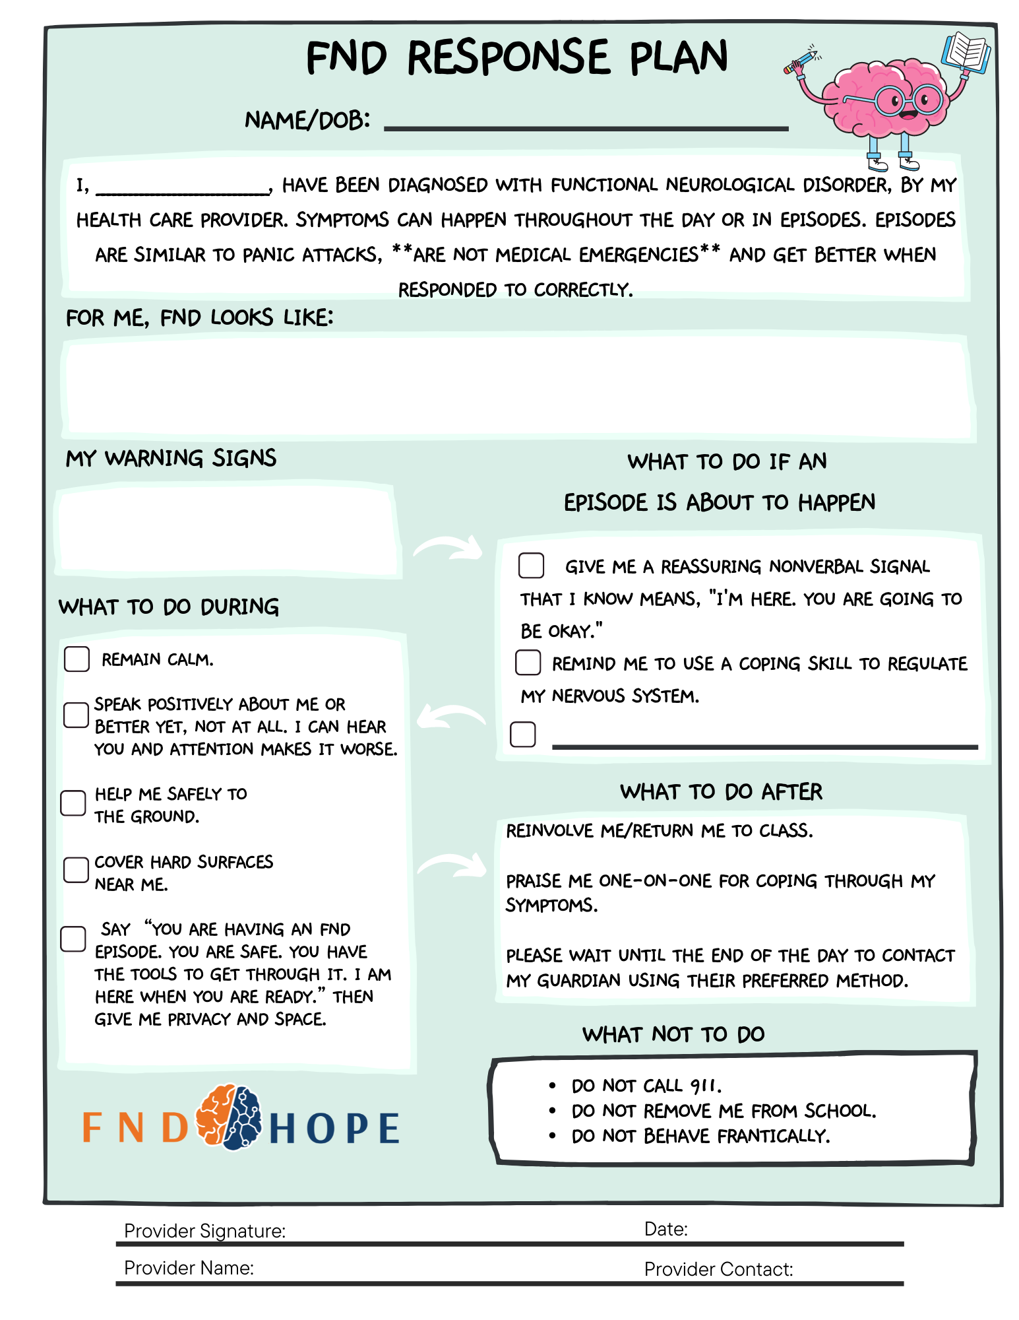

Slide 34
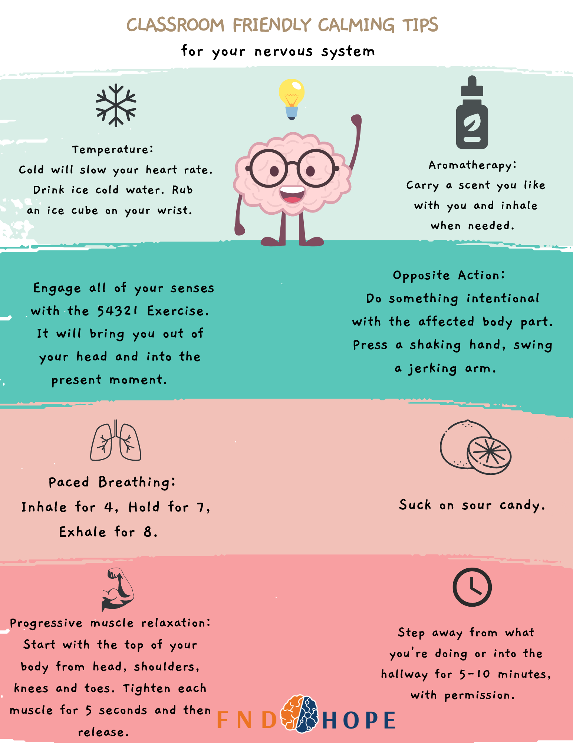

Slide 35
PNES
The more focus and stimulation that is centered on the student the longer spells tend to last.
Ideally student is moved to a safe/less disruptive area at the beginning of the event or when they feel one is about start.
No need to clear the classroom
Student should essentially be left to their own devices. Okay to monitor but should not be surrounded, shaking, asked questions, or other targeted stimulation
Additional recommendations/ways of supporting may be outlined in a response plan

Slide 36
Features we will want to know
Event Features
Posture
Eyes
Shaking
Responsiveness
Timeline (length of the episodes, space between episodes, clustering?)
What is the student like before and after the episode?
If the student has not yet been diagnosed with PNES, a video or very clear description can be helpful for providers.

Slide 37
Functional Weakness in School
May require wheelchairs or other support devices
Don’t focus on the weakness or push kids to move that part of the body - focusing on the weak limb is more likely to worsen symptoms than improve them
Will often require missing PE
Try and find alternative physical activities rather than just missing class entirely

Slide 38
General Caveat
If you feel a student is in danger or medically unstable it is never *wrong* to call 911. Most important element is safety.

Slide 39
School letter
To whom it may concern:
I am writing to provide a brief overview of the clinical condition and support needs of NAME. NAME has been diagnosed with functional neurological disorder, which is when symptoms concerning for neurological pathology are instead due to inefficient communication between parts of the brain. These can be body’s reaction to coping with negative emotions and stress. These episodes are not medically dangerous; therefore, they do not need medical intervention during or after the episode.
This letter is meant to assist school staff in responding to NAMEs episodes and is not meant to provide general recommendations for other behaviors or medical conditions that NAME may have.
Description of episodes: ***
If NAME is having an episode do not call 911 or send them to the hospital unless you believe the episode to be significantly different from their prior episodes and/or they are not breathing adequately.
If NAME has lost awareness, help them to stay safe, do not hold them, or touch them unless you are trying to prevent them from falling or injuring themselves. Moving to a safe quiet place should ideally be done prior to the student losing awareness (such as a quiet hallway, nurse’s office, adjacent empty classroom). Do not continue talking to NAME once they has lost awareness.
Additional accommodations may be helpful, and we are happy to help advise you about additional supports as they will be following up with one of our neurologists that cares for patients with functional neurological disorders.

Slide 40
Some useful websites
https://fndhope.org/
Patient focused site with valuable information and provider directory
https://www.neurosymptoms.org/
Detailed in depth information about a wide variety of FNDs and how they are managed
https://www.fndsociety.org/
International organisation for FNDs

Slide 41
References
Fritzsche K, Baumann K, Götz-Trabert K, Schulze-Bonhage A. Dissociative seizures: a challenge for neurologists and psychotherapists. Deutsches Arzteblatt international. 2013;110(15):263-268.
Popkirov S, Asadi-Pooya AA, Duncan R, et al. The aetiology of psychogenic non-epileptic seizures: risk factors and comorbidities. Epileptic disorders : international epilepsy journal with videotape. 2019;21(6):529-547.
Anzellotti F, Dono F, Evangelista G, et al. Psychogenic non-epileptic seizures and pseudo-refractory epilepsy, a management challenge. Front Neurol. 2020;11:461.
Nicholson TR, Carson A, Edwards MJ, et al. Outcome measures for functional neurological disorder: a review of the theoretical complexities. J Neuropsychiatry Clin Neurosci. 2020;32(1):33-42.
Perjoc RS, Roza E, Vladacenco OA, Teleanu DM, Neacsu R, Teleanu RI. Functional neurological disorder-old problem new perspective. Int J Environ Res Public Health. 2023;20(2):1099.
Janssen-Aguilar R, Galíndez-de la Portilla JP, Gómez-Alcorta R, et al. Impact of the COVID-19 pandemic on the incidence of patients with functional neurological disorder seen in a neurological emergency department. Psychiatry Clin Neurosci. 2022;76(11):595-596.
Hull, M.; Parnes, M.; Jankovic, J. Increased Incidence of Functional (Psychogenic) Movement Disorders in Children and Adults Amid the COVID-19 Pandemic: A Cross-sectional Study. Neurol. Clin. Pract. 2021, 11, e686–e690.
Kutlubaev, M.A.; Xu, Y.; Hackett, M.L.; Stone, J. Dual diagnosis of epilepsy and psychogenic nonepileptic seizures: Systematic review and meta-analysis of frequency, correlates, and outcomes. Epilepsy Behav. 2018, 89, 70–78.
Yadav, A.; Agarwal, R.; Park, J. Outcome of psychogenic nonepileptic seizures (PNES) in children: A 2-year follow-up study. Epilepsy Behav. 2015, 53, 168–173.

Slide 42
Questions?
For any questions, comments, or a copy of the slides, feel free to reach out:
Cynthia.j.morris@health.slu.edu

Slide 44
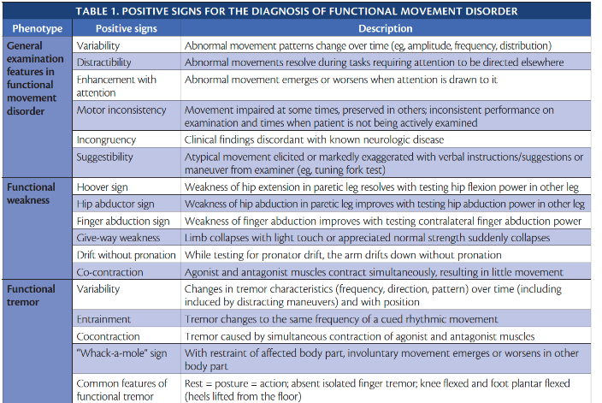

Slide 45
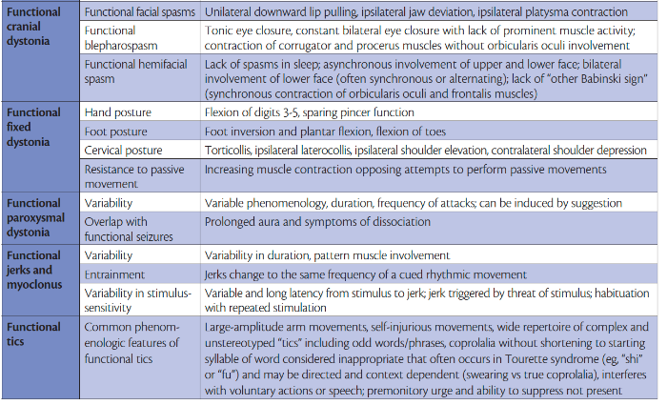

Slide 46
